Slide 1

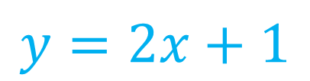


Algebra Interactive Notebook
$$3ab$$
$$\frac{5xy}{6}$$
Name :
Class :
Term 1 Semester 1
$$2x+3y$$
$$y=2x+1$$

Slide 2
Contents
Glossary
Page
Date
Description
2
3

Slide 3
Tasks
24
7
30
Essential Question
Questions
Notes
Summary
4
7

Slide 4
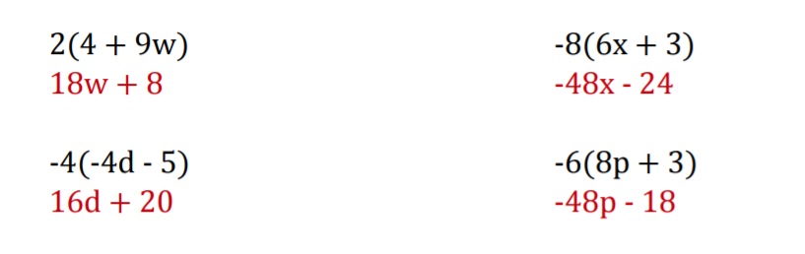
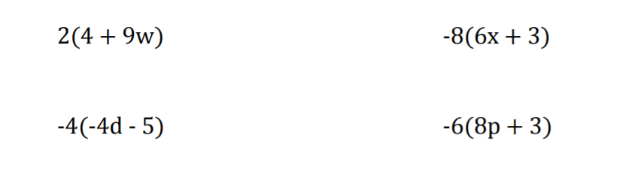
revision

Slide 5









Simplifying Expressions
24
7
30
EQ: How do I factorise algebraic expressions?
Find is the HCF
(HIGHEST common factor)
8 = 1, 2, 4, 8
20 = 1, 2, 4, 5, 10, 20
How do I factorise?
$$8x + 20$$
$$____ ( ____ + ____ )$$
$$4$$
$$2x$$
$$5$$
$$×$$
$$×$$
$$8x$$
$$+$$
$$20$$

Slide 6
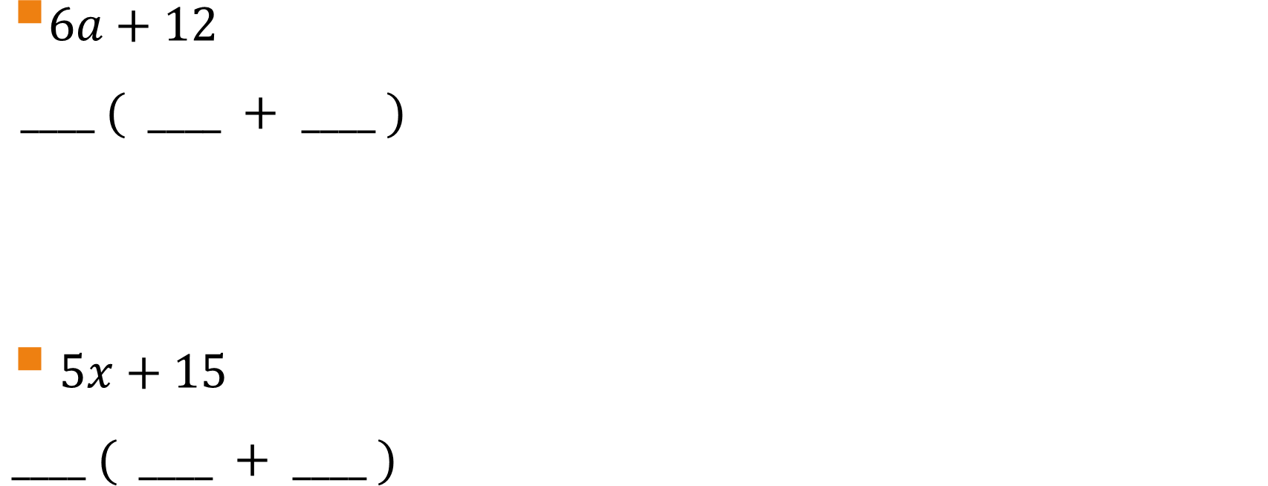
Practice:
$6a+12$
$____ ( ____ + ____ )$
$5x+15$
$____ ( ____ + ____ )$

Slide 7








Simplifying Expressions
24
7
30
EQ: How do I factorise algebraic expressions?
Find is the HCF
(HIGHEST common factor)
15 = 1, 3, 5, 15
20 = 1, 2, 4, 5, 10, 20
How do I factorise?
$$15x + 20x$$
$$____ ( ____ + ____ )$$
$$4$$
2. Same variables??
$$x$$
$$3$$
$$5$$
$$×$$
$$×$$
$$15x$$
$$+$$
$$20x$$

Slide 8






Simplifying Expressions
24
7
30
EQ: How do I factorise algebraic expressions?
Find is the HCF
(lHIGHEST common factor)
How do I factorise?
$$18x²+ 20xy$$
$$____ ( ____ + ____ )$$
$$10y$$
2. Same variables??
$$2$$
$$x$$
$$9x$$
$$×$$
$$×$$
$$18x²$$
$$+$$
$$20xy$$

Slide 9
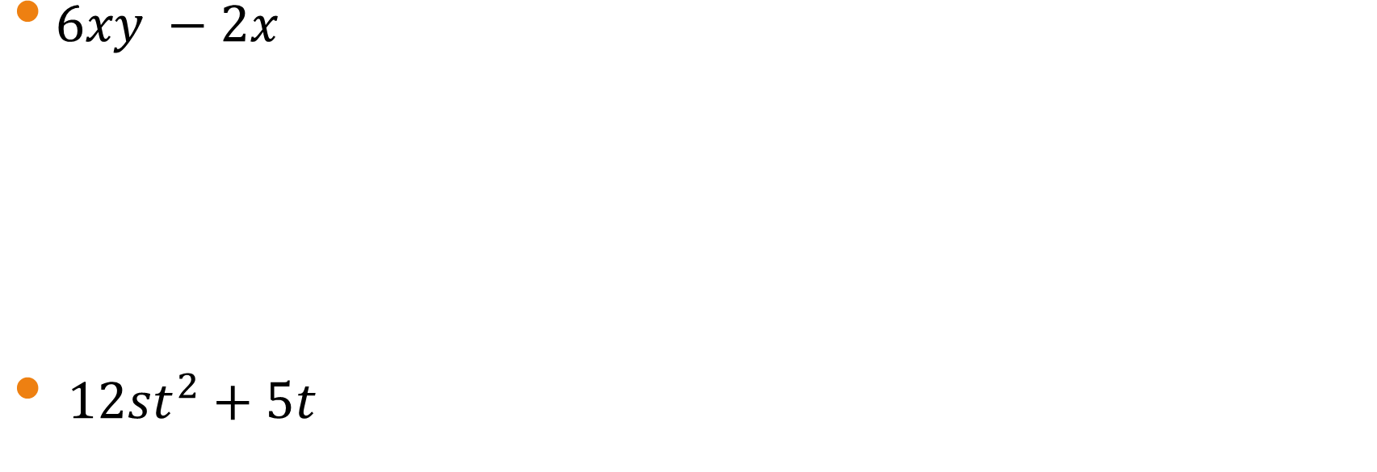
Practice:
$6xy −2x$
$12st^{2}+5t$

Slide 10
Exit pass – OK CHAMPIONS LETS SEE WHAT YOU HAVE LEARNT??
Place 7 questions on the board for YOUR LEGENDARY students to answer.
CHOOSE FROM THE FOLLOWING CATEGORIES:
Adding LIKE TERMS
Subtracting LIKE TERMS
MULTIPLYING LIKE TERMS
DIVIDING LIKE TERMS
FACTORISING
EXPANDING BRACKETS

